Slide 1


Slide 2
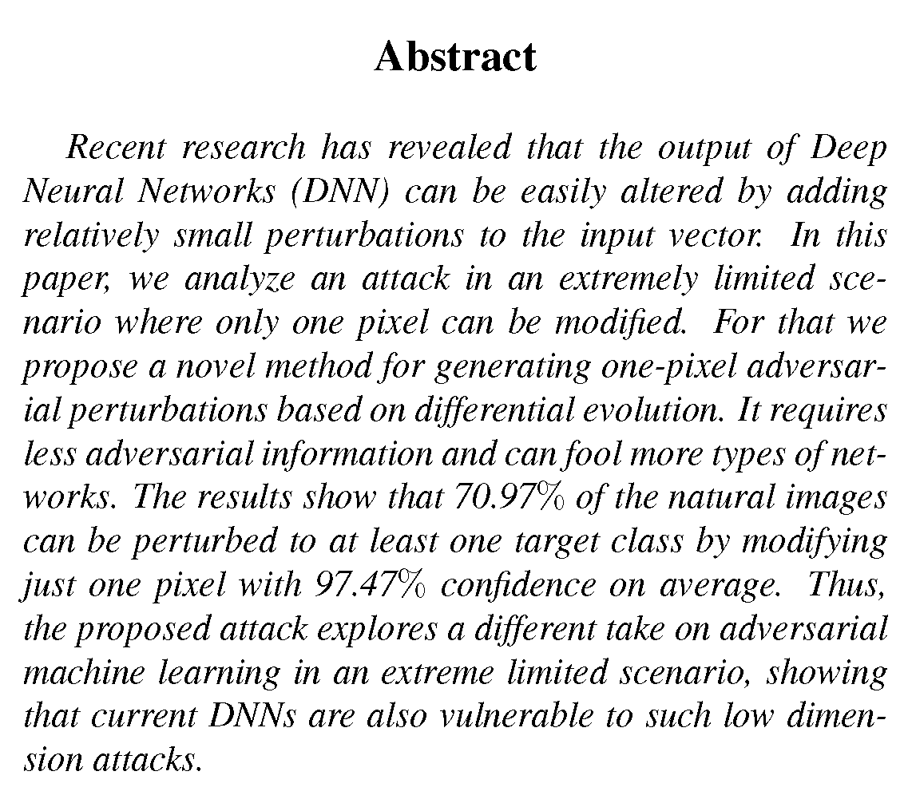

Slide 3
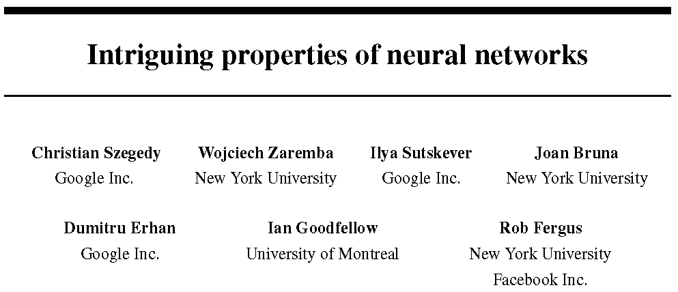
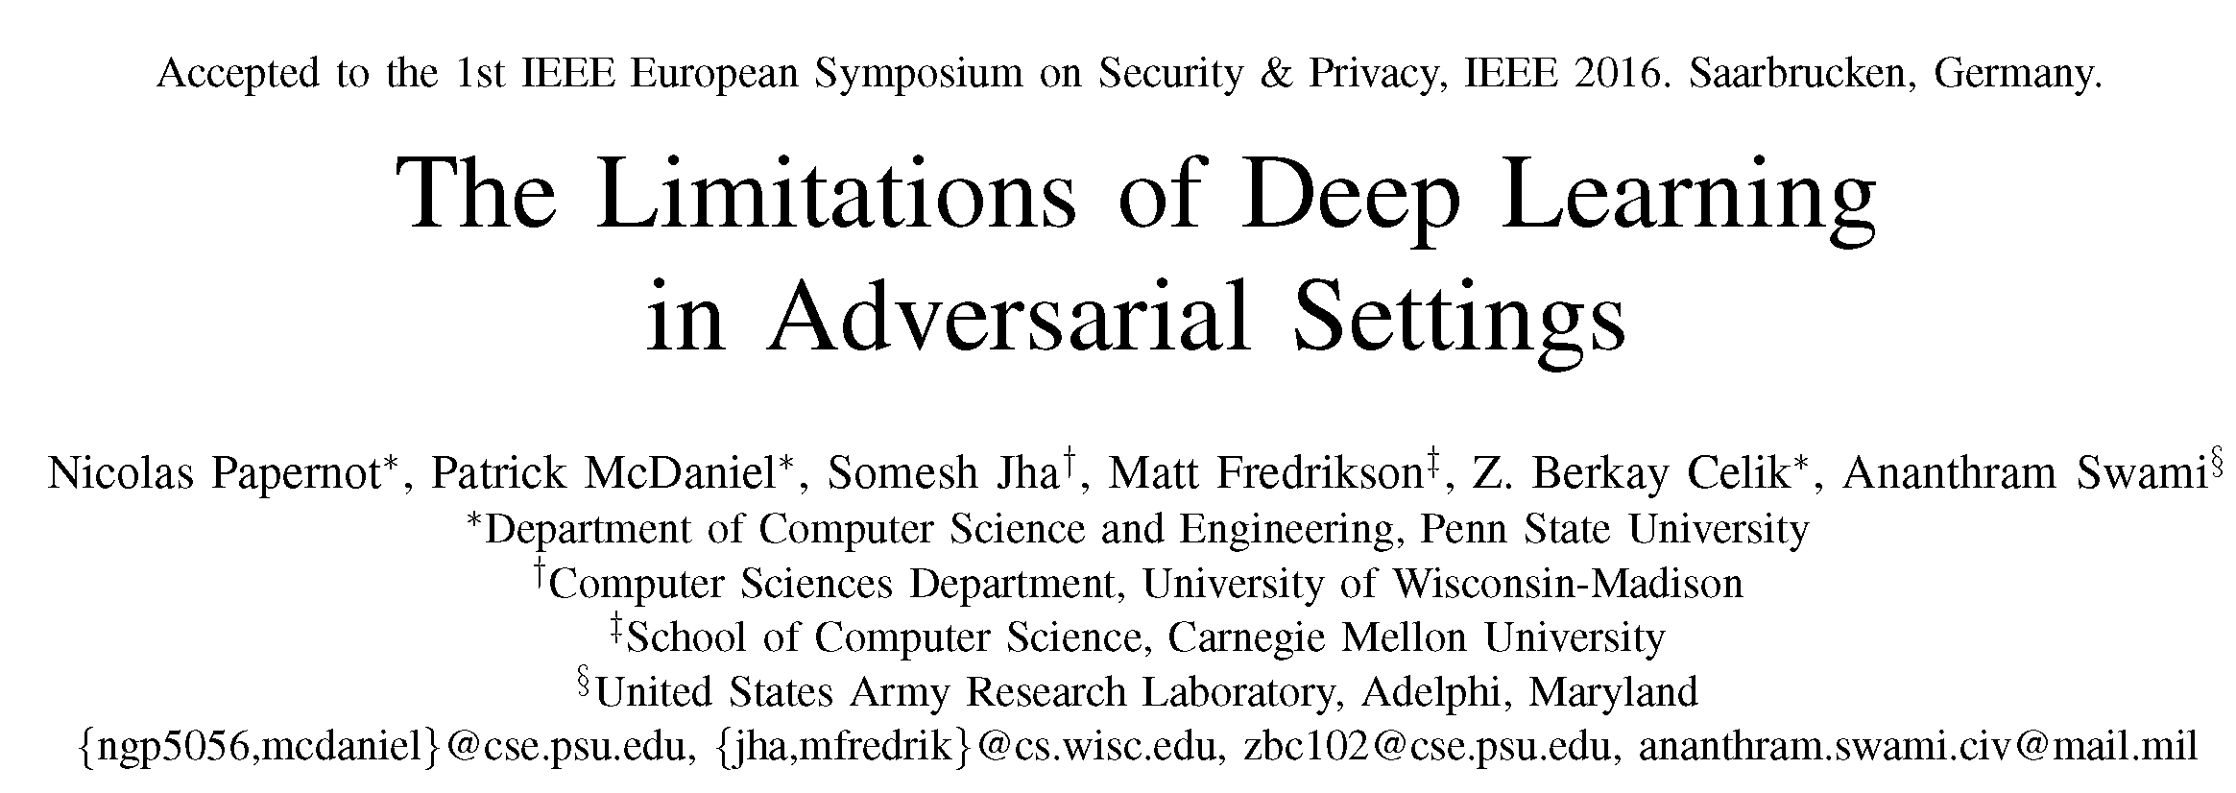
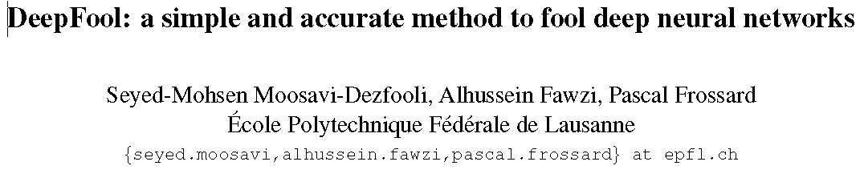
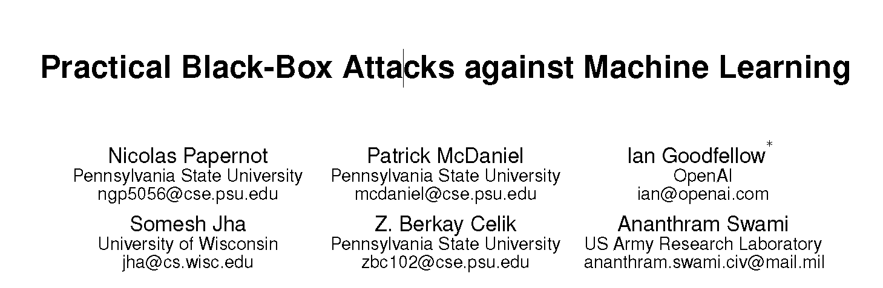
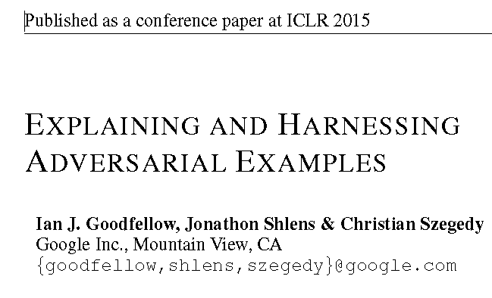
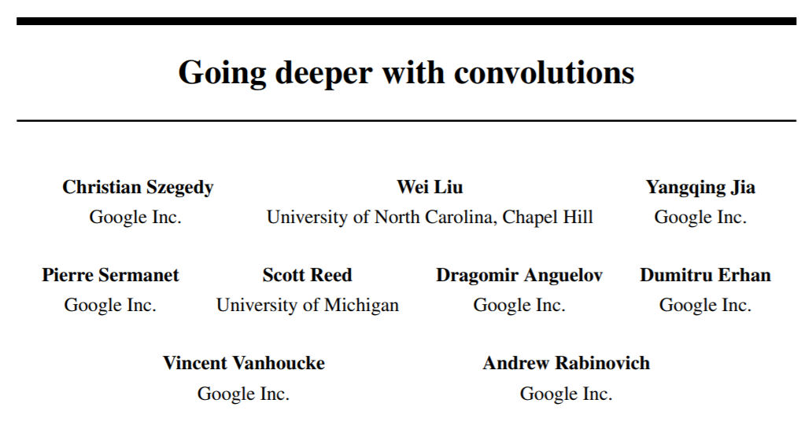
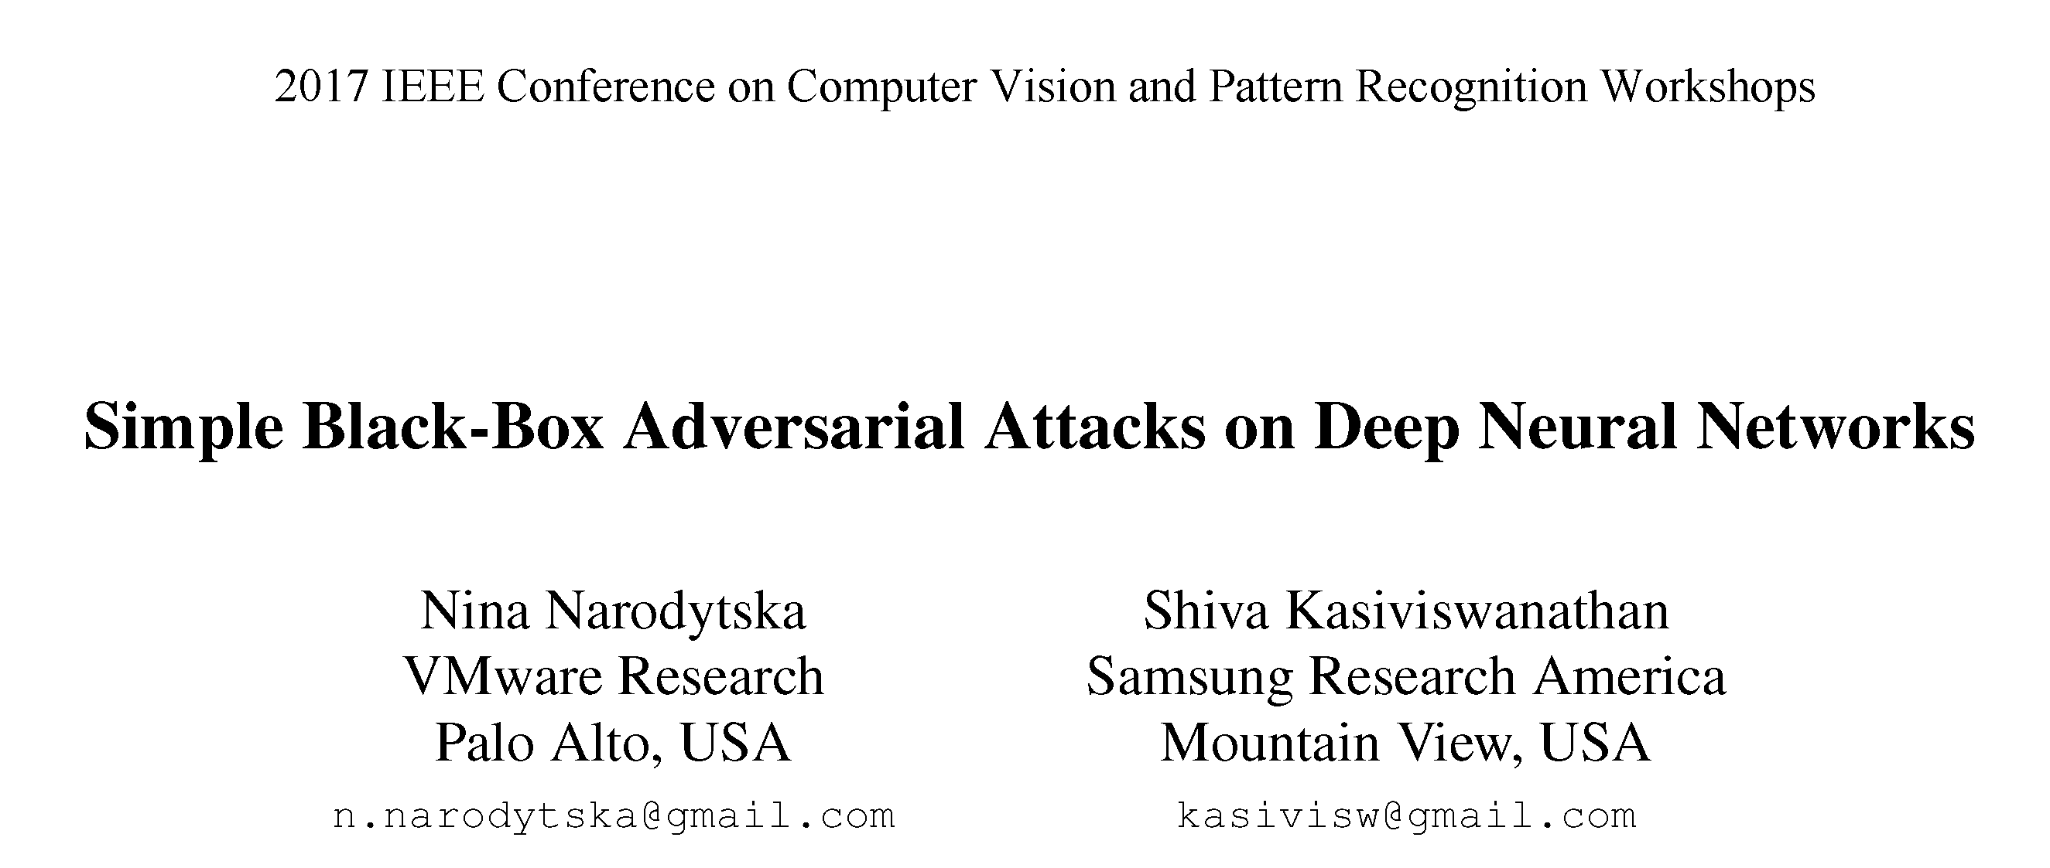

Slide 4
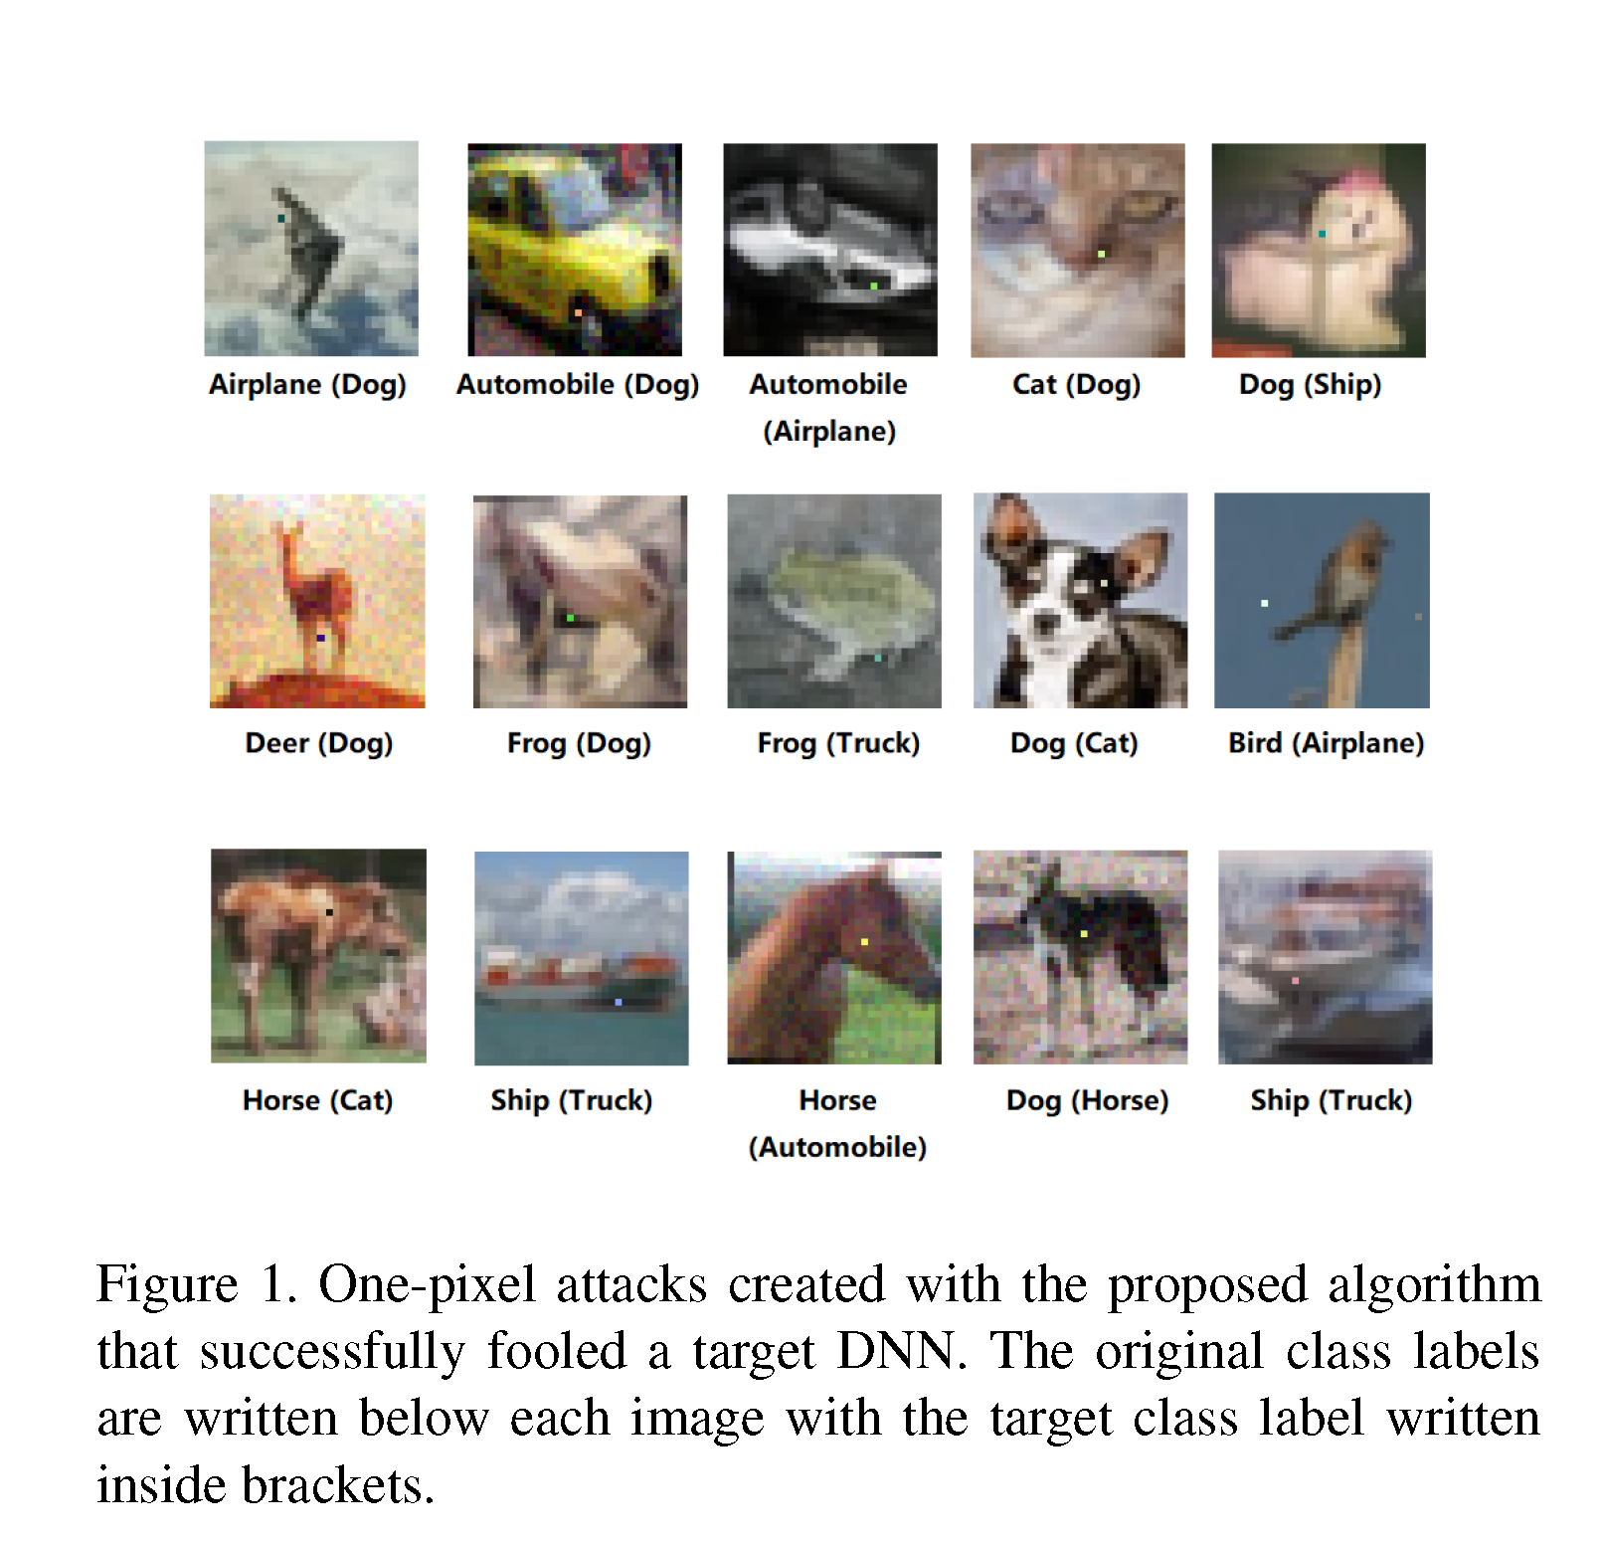

Slide 5
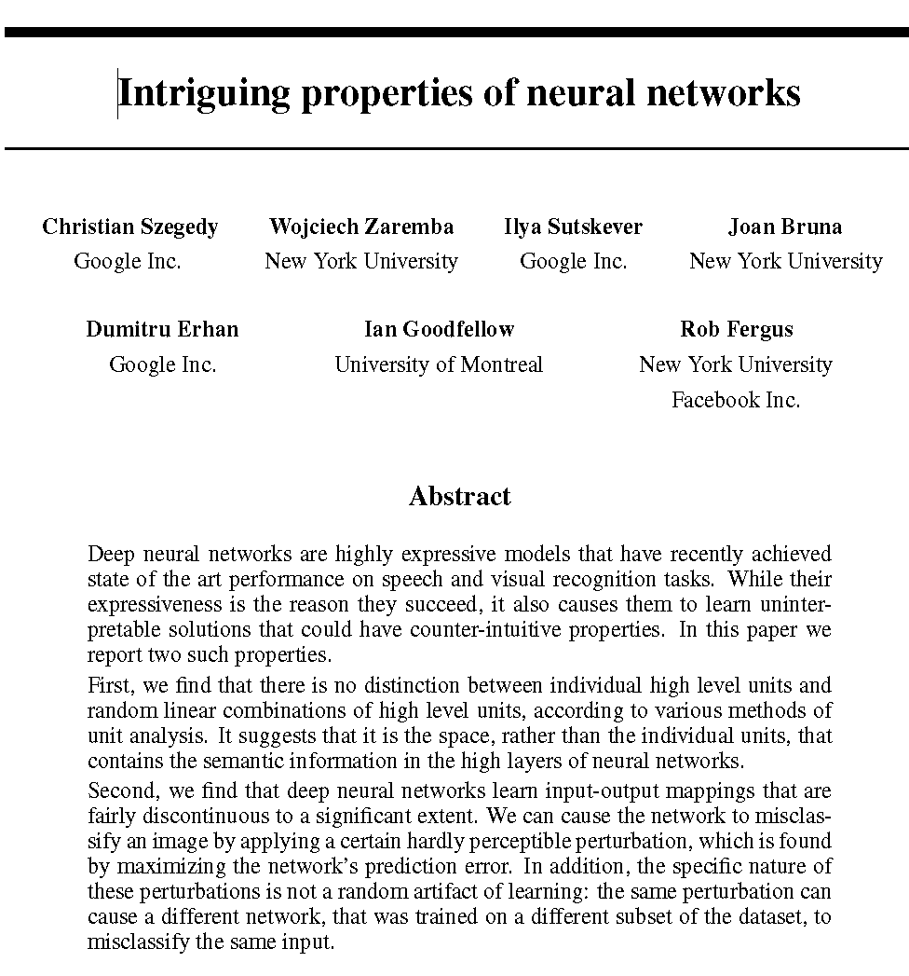

Slide 7
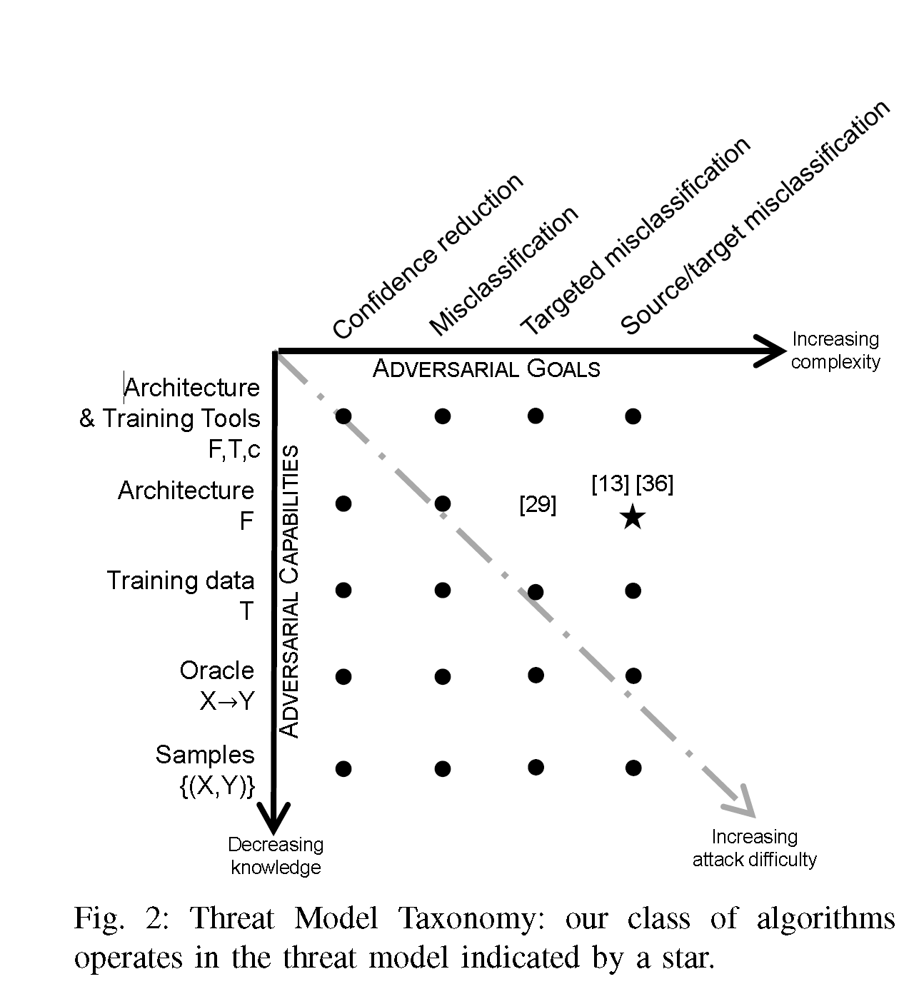

Slide 8
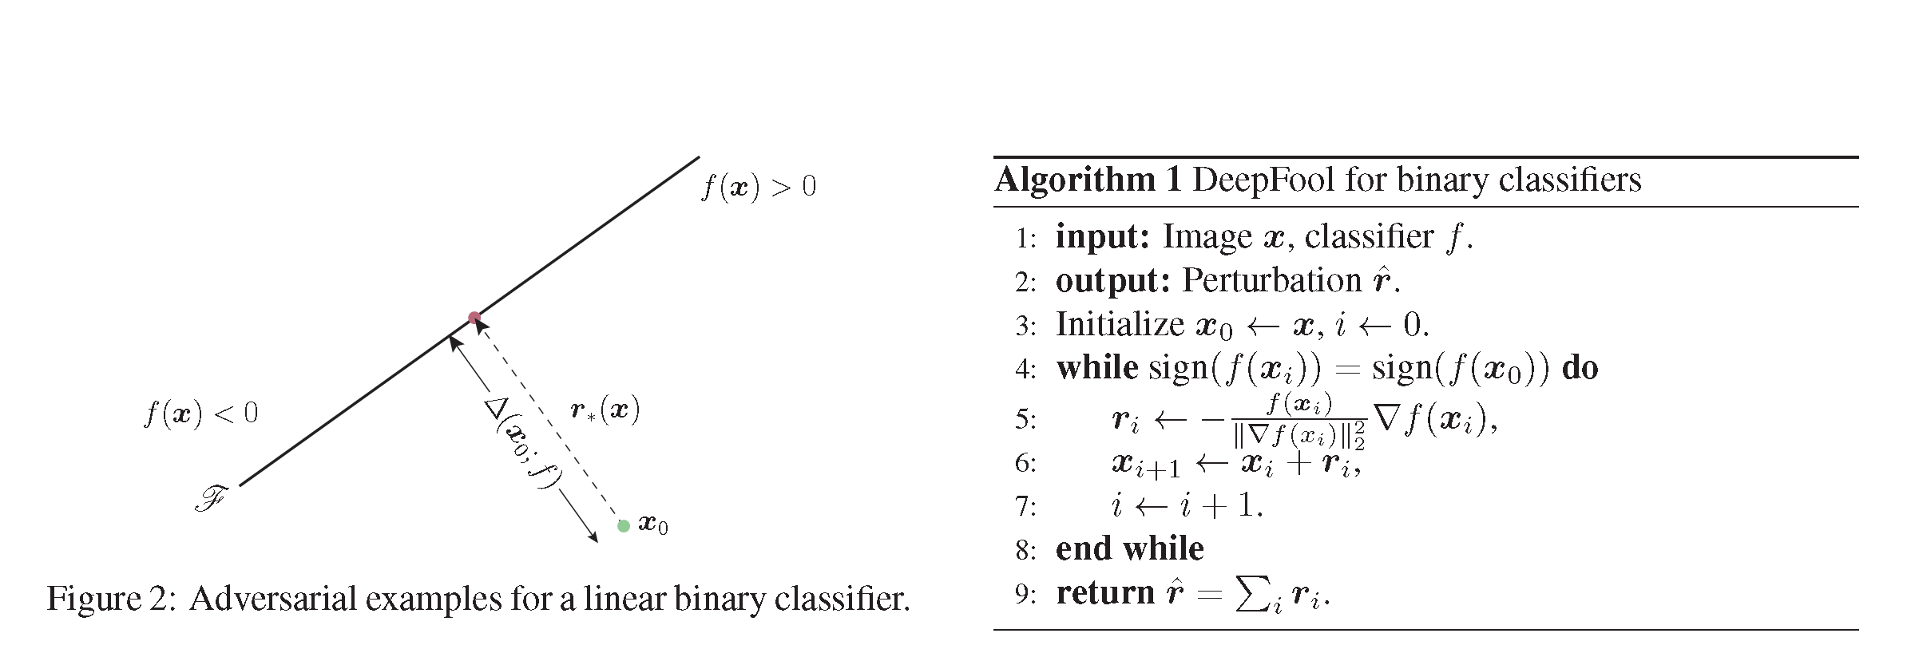

Slide 10
Introduction
Image Recognition
Effectiveness
Semi-Black-Box-Attack (Requires only black-box feedback, i.e. probabilities but nothing about inside of DNN)
Flexibility – can attack more types of DNNs
Why one-pixel?
  Analyze the Vicinity of Natural Images
  A Measure of Perceptiveness (hiding adversarial modification in practice)

Slide 11
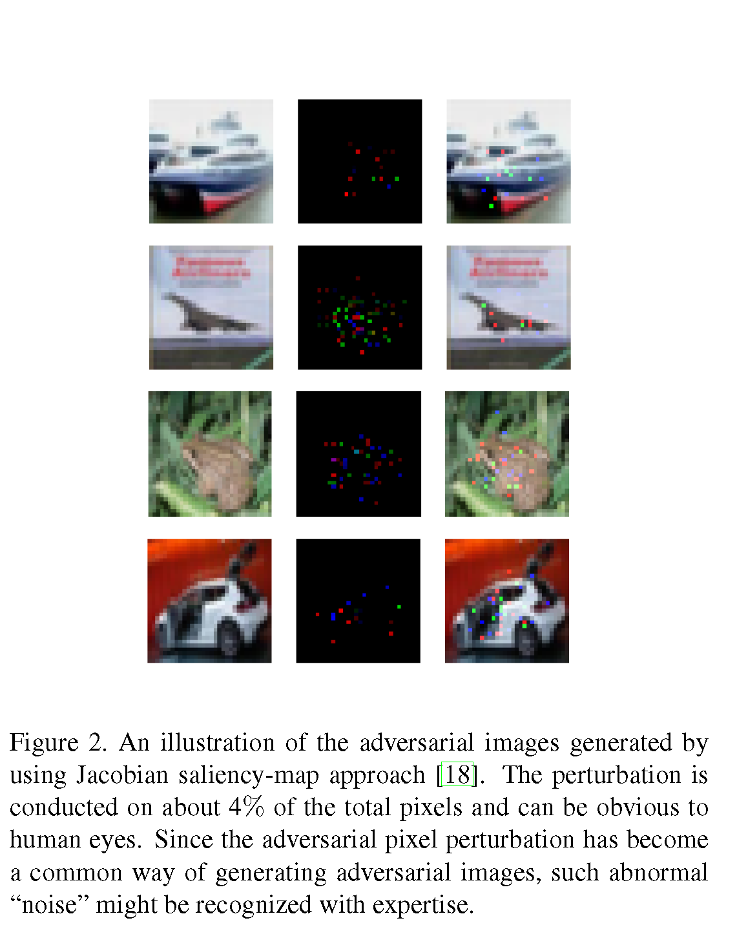

Slide 12
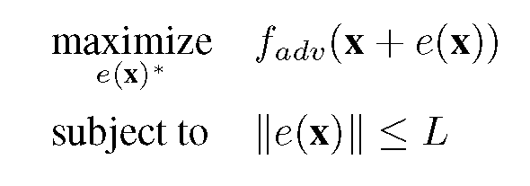
Obligatory “Math” Slide
Define f(x) as the target image classifier
x: is the image vector (x₁,….,x_{n})
Probability of x belonging to class t is given as f_{t}(x)
Define the additive perturbation vector e(x) =(e₁,….,e_{n})
Define adv as the target class
Define L as the limit of the modification

Slide 13
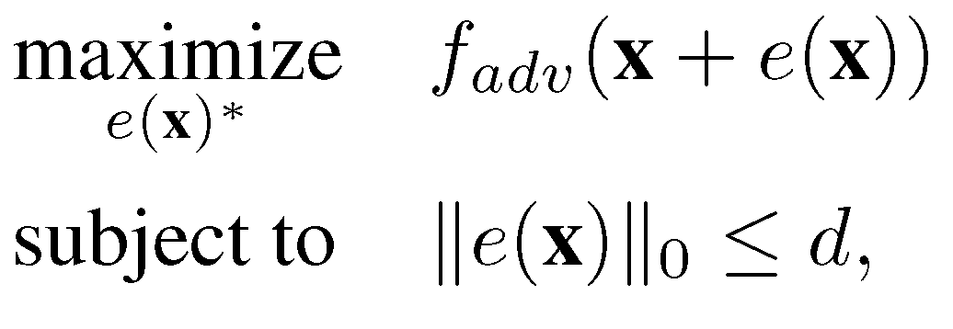
Sparse Version

Slide 14
Optimization
Will not discuss here
The use of a method called “Differential Evolution”
  Evolutionary algorithm
  Key is that this does not use Gradient Information so Objective function need not be known (though I guess they can always try numerical differentiation)

Slide 15
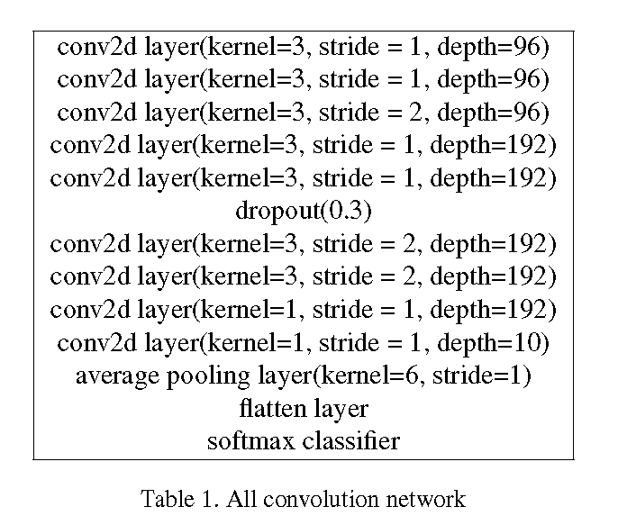
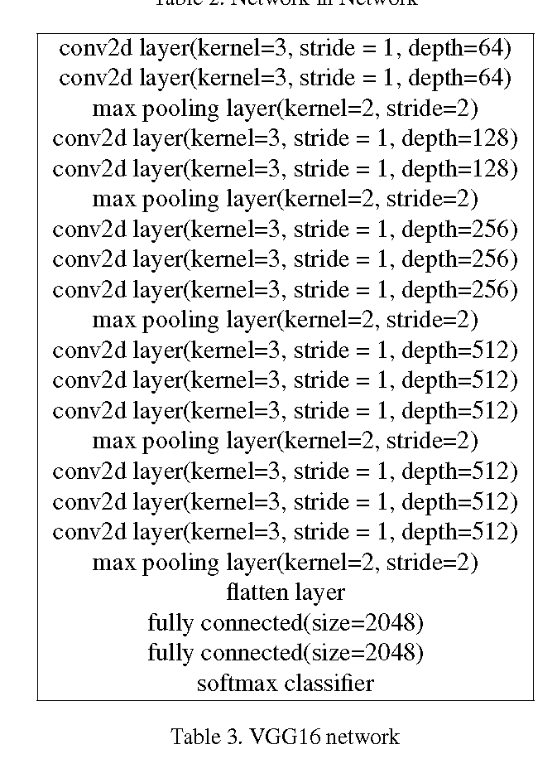
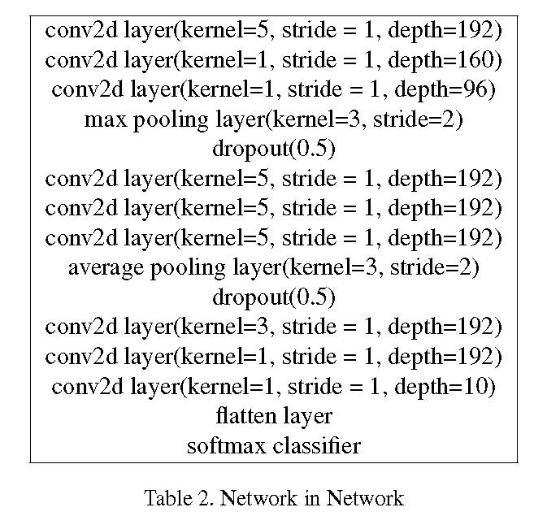
Results
Test again 3 types of networks
  All Convolutional Network
  Network-in-Network
  VGG16
Cifar-10 data set (10 classes)
Selected 500 natural images to contact the attack

Slide 16
Some Terms
Non-targeted attack: Change the label
Targeted attack: Change the label to specific value
Success Rate: % of adversarial images that were successfully classified (misclassified)
Adversarial Probability Labels: Accumulates the values of probability label of the target class for each successful perturbation, then divided by the total number of successful perturbations. The measure indicates the average confidence given by the target system when misclassifying adversarial samples.

Slide 17
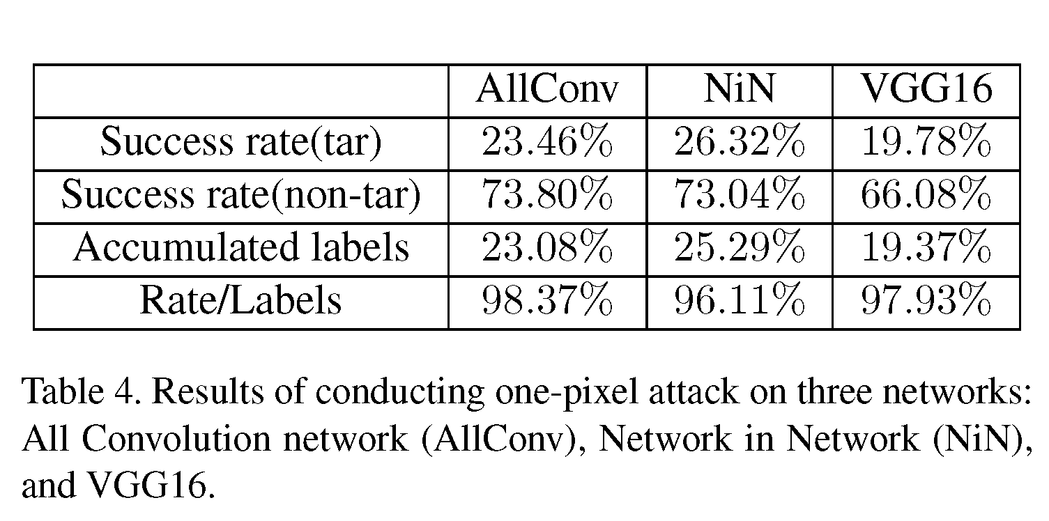
One-pixel attack results

Slide 18
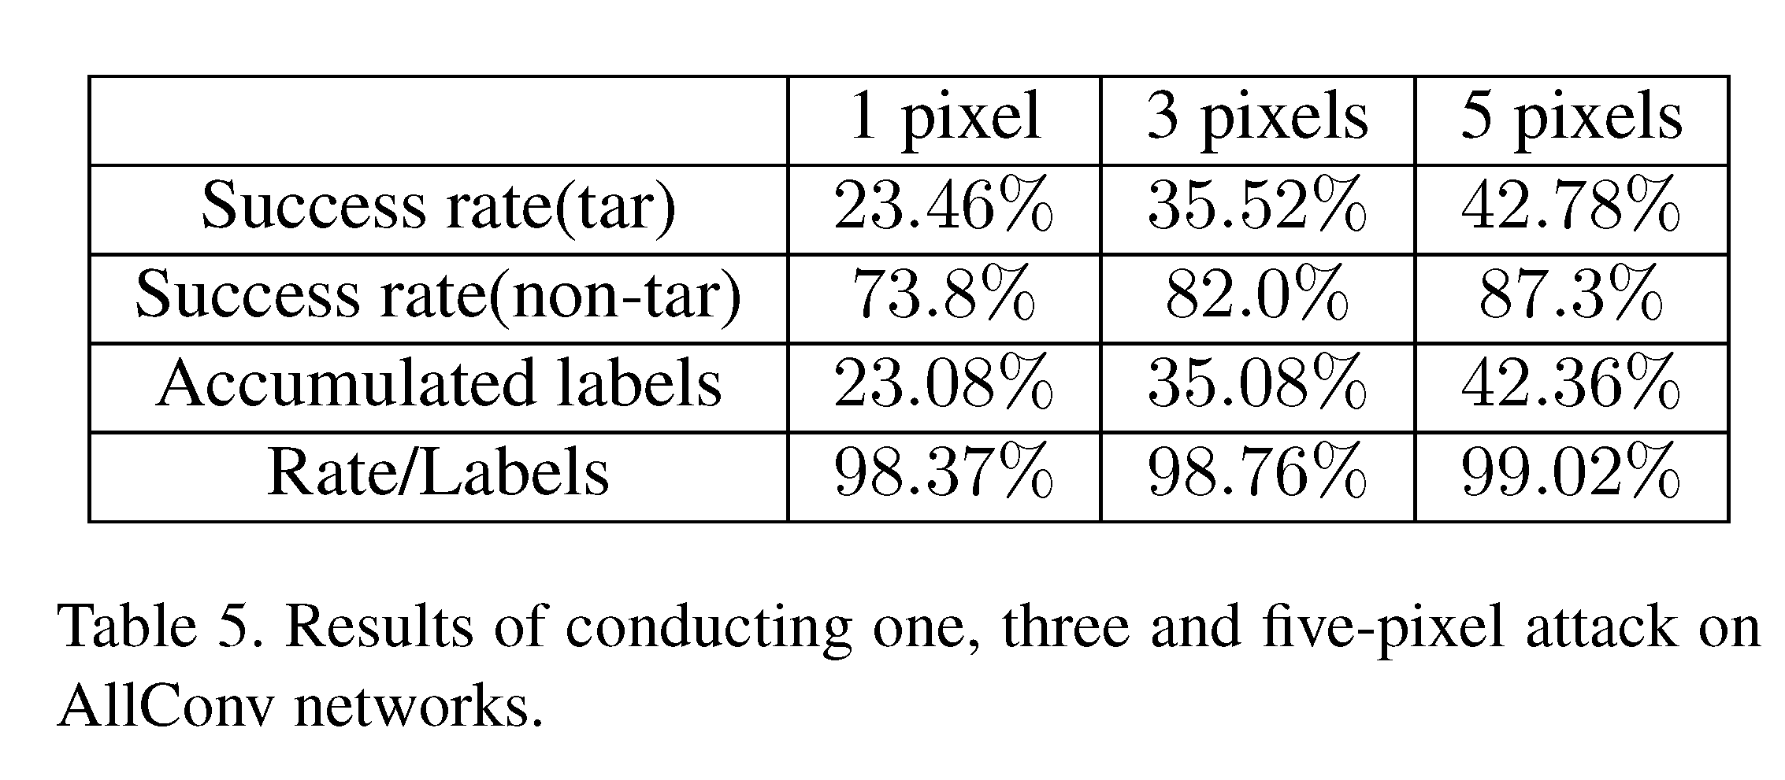
1,3,5 pixel attacks

Slide 19
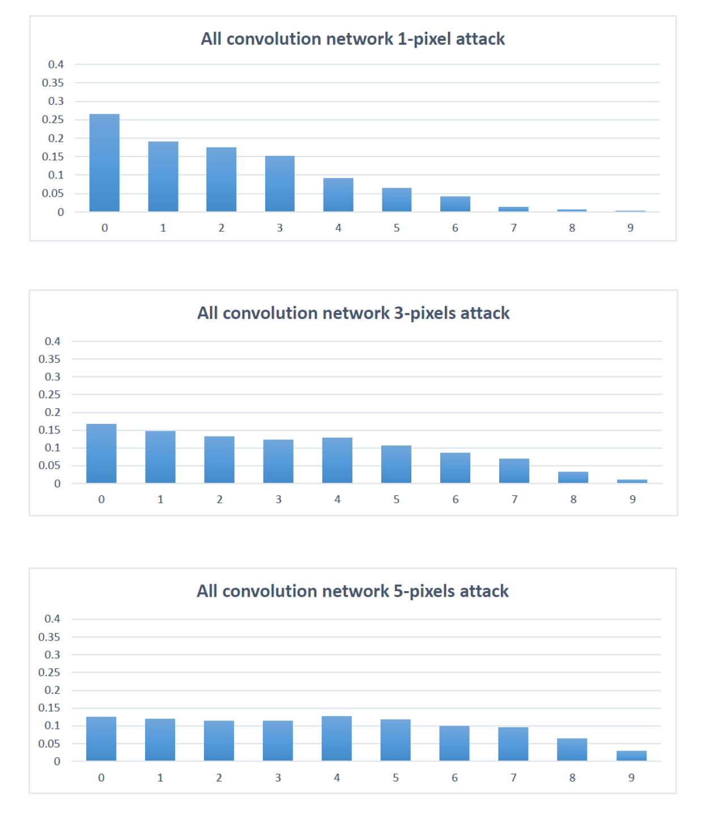
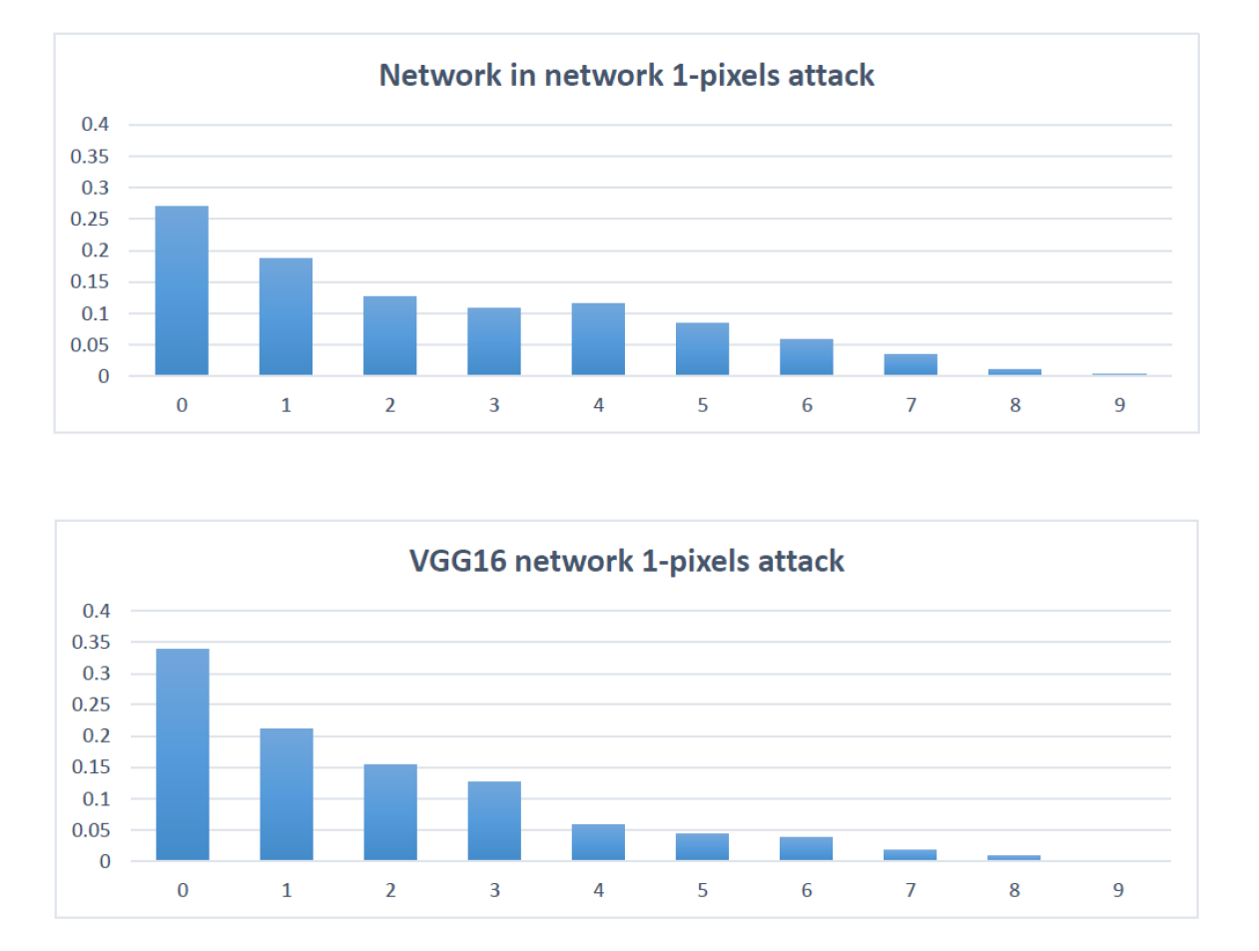
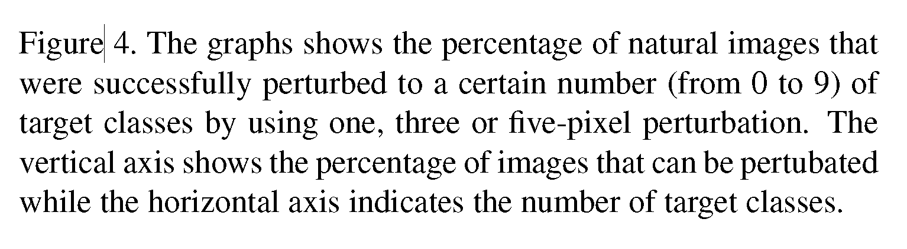

Slide 20
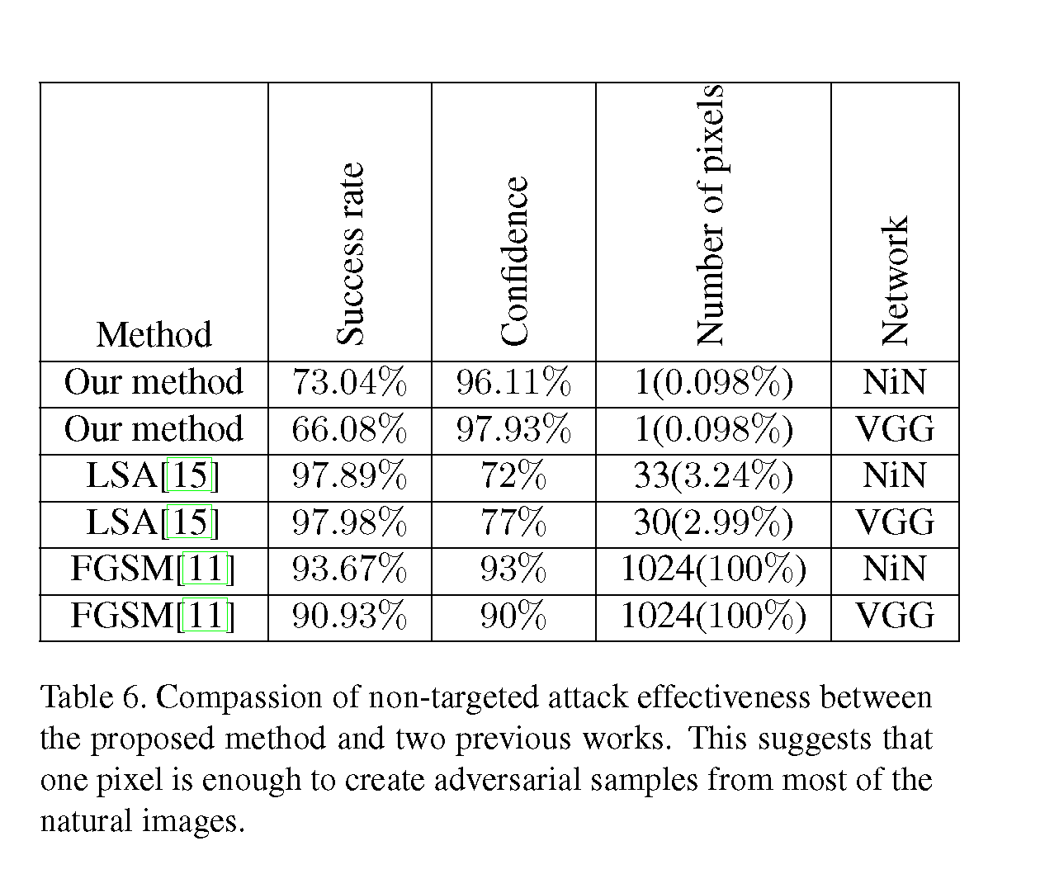

Slide 21
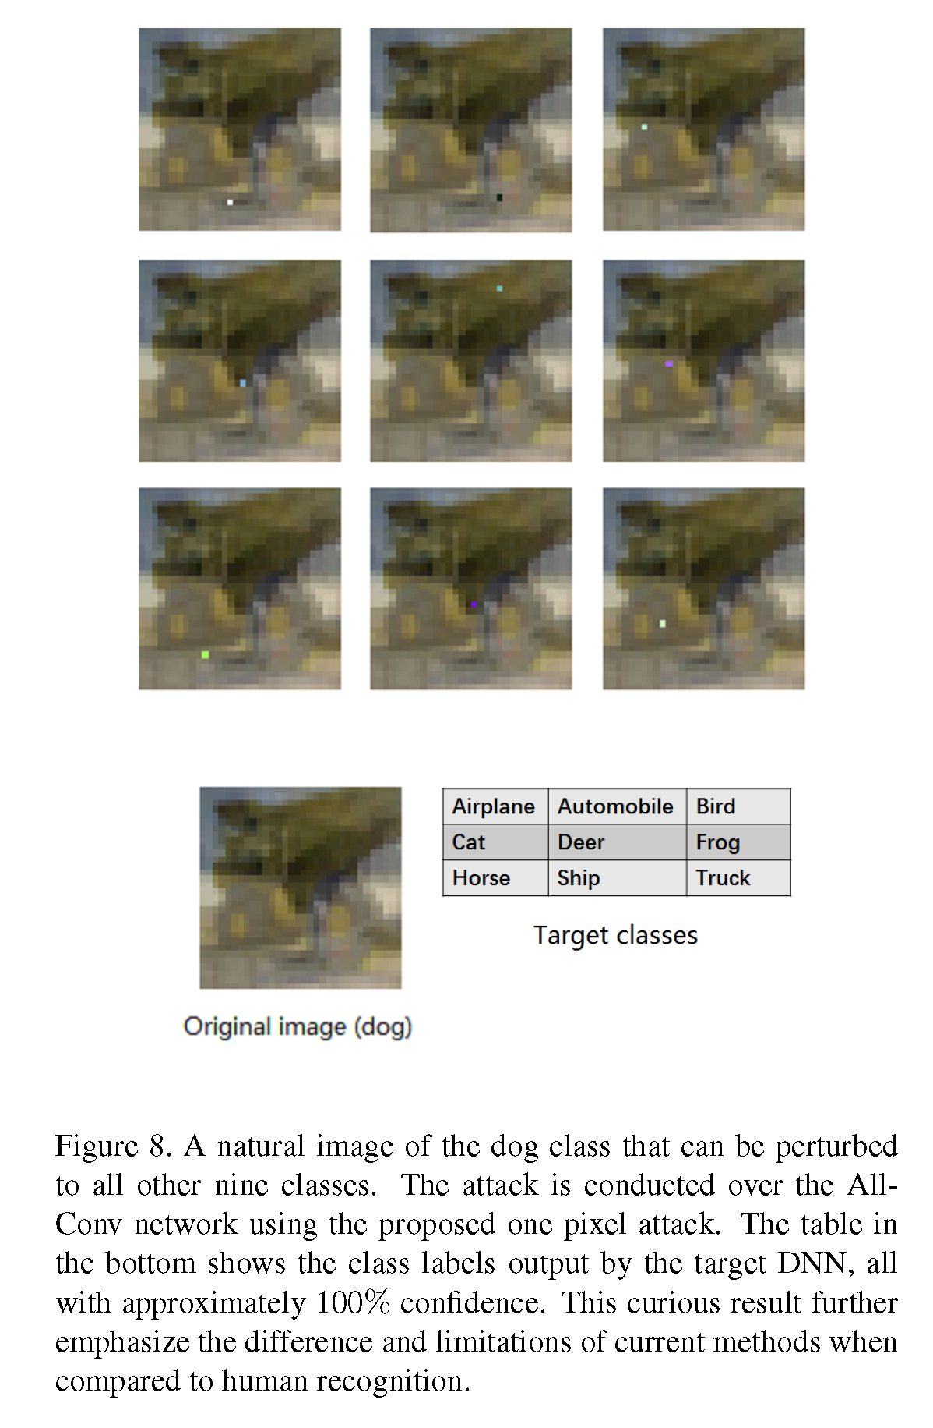

Slide 22
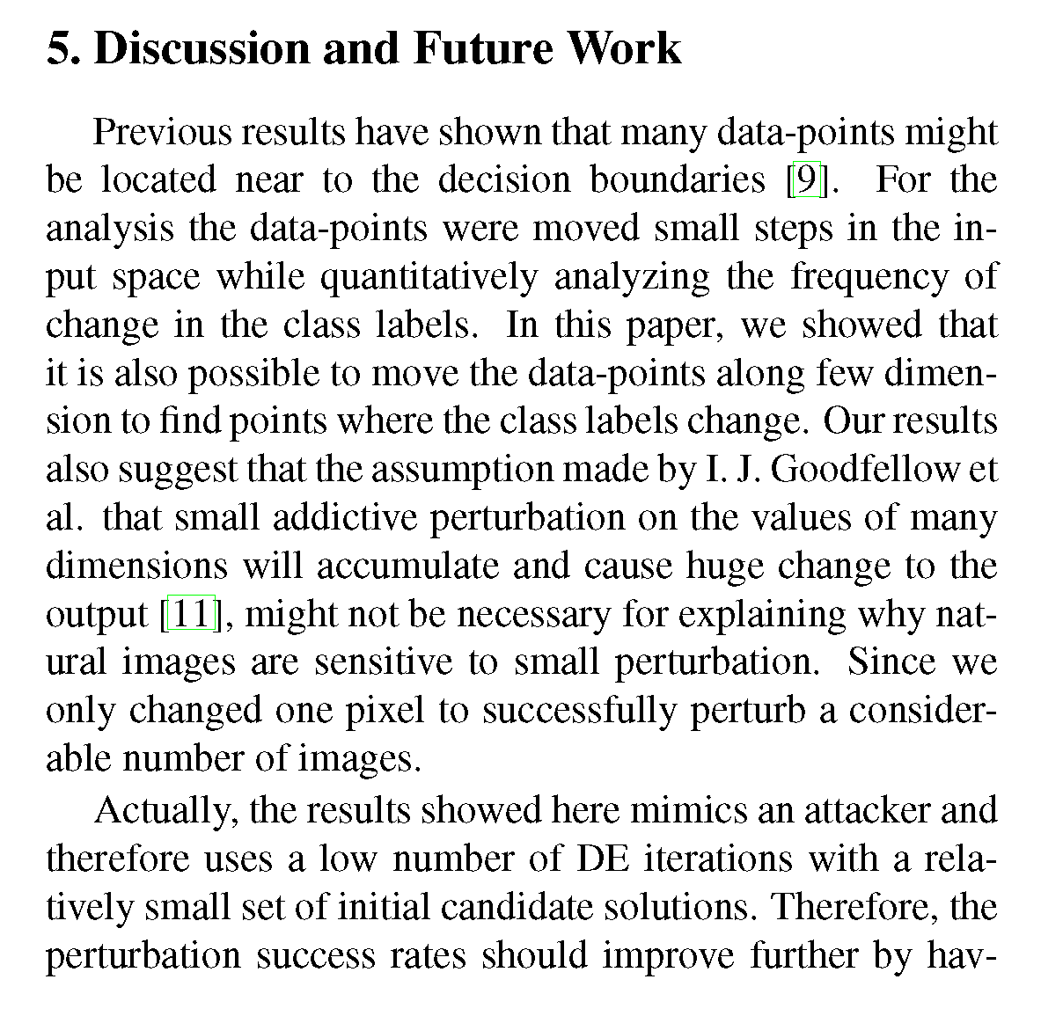
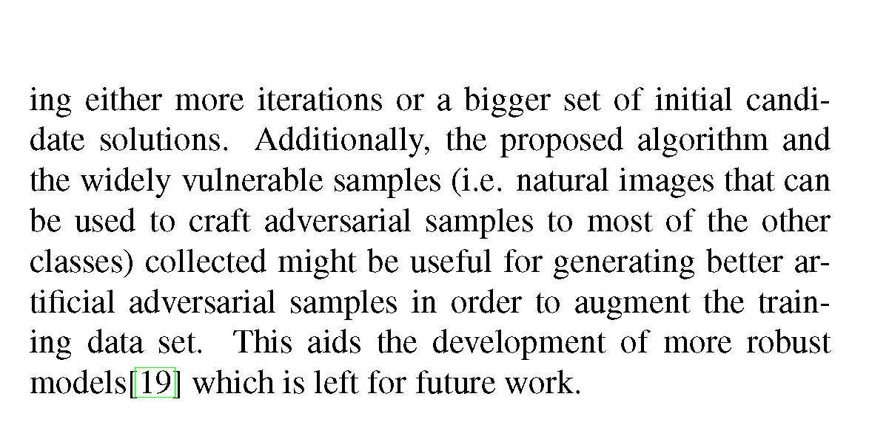

Slide 23
Classifier Example

